Slide 1
Roque JoaquÍn de Alcubierre
Ava Valentino

Slide 2
Early Life
Born in Zaragoza, Spain – August 16, 1702
Aroganese
General education
Ties w Count of Bureta
Volunteered in army 1711

Slide 3
Military Life
Engineer – Royal Military Engineer Corps
Trained on the banks of the Ebro
1731-1733: Gerona, Barcelona, Madrid
Promoted as Captain in 1738
Lieutenant-Colonel in 1750
Field Marshall in 1777
Notes:
Admittance into corps but denied

Slide 4
Career
Worked for King Charles of Naples
Portici, Italy
Rumors of “treasure”
1738 excavation -Theater of Herculaneum
“Trial and error” archaeology
Notes:
the techniques of archaeological extraction of this period suffered from lack of preparation and professionalism

Slide 5
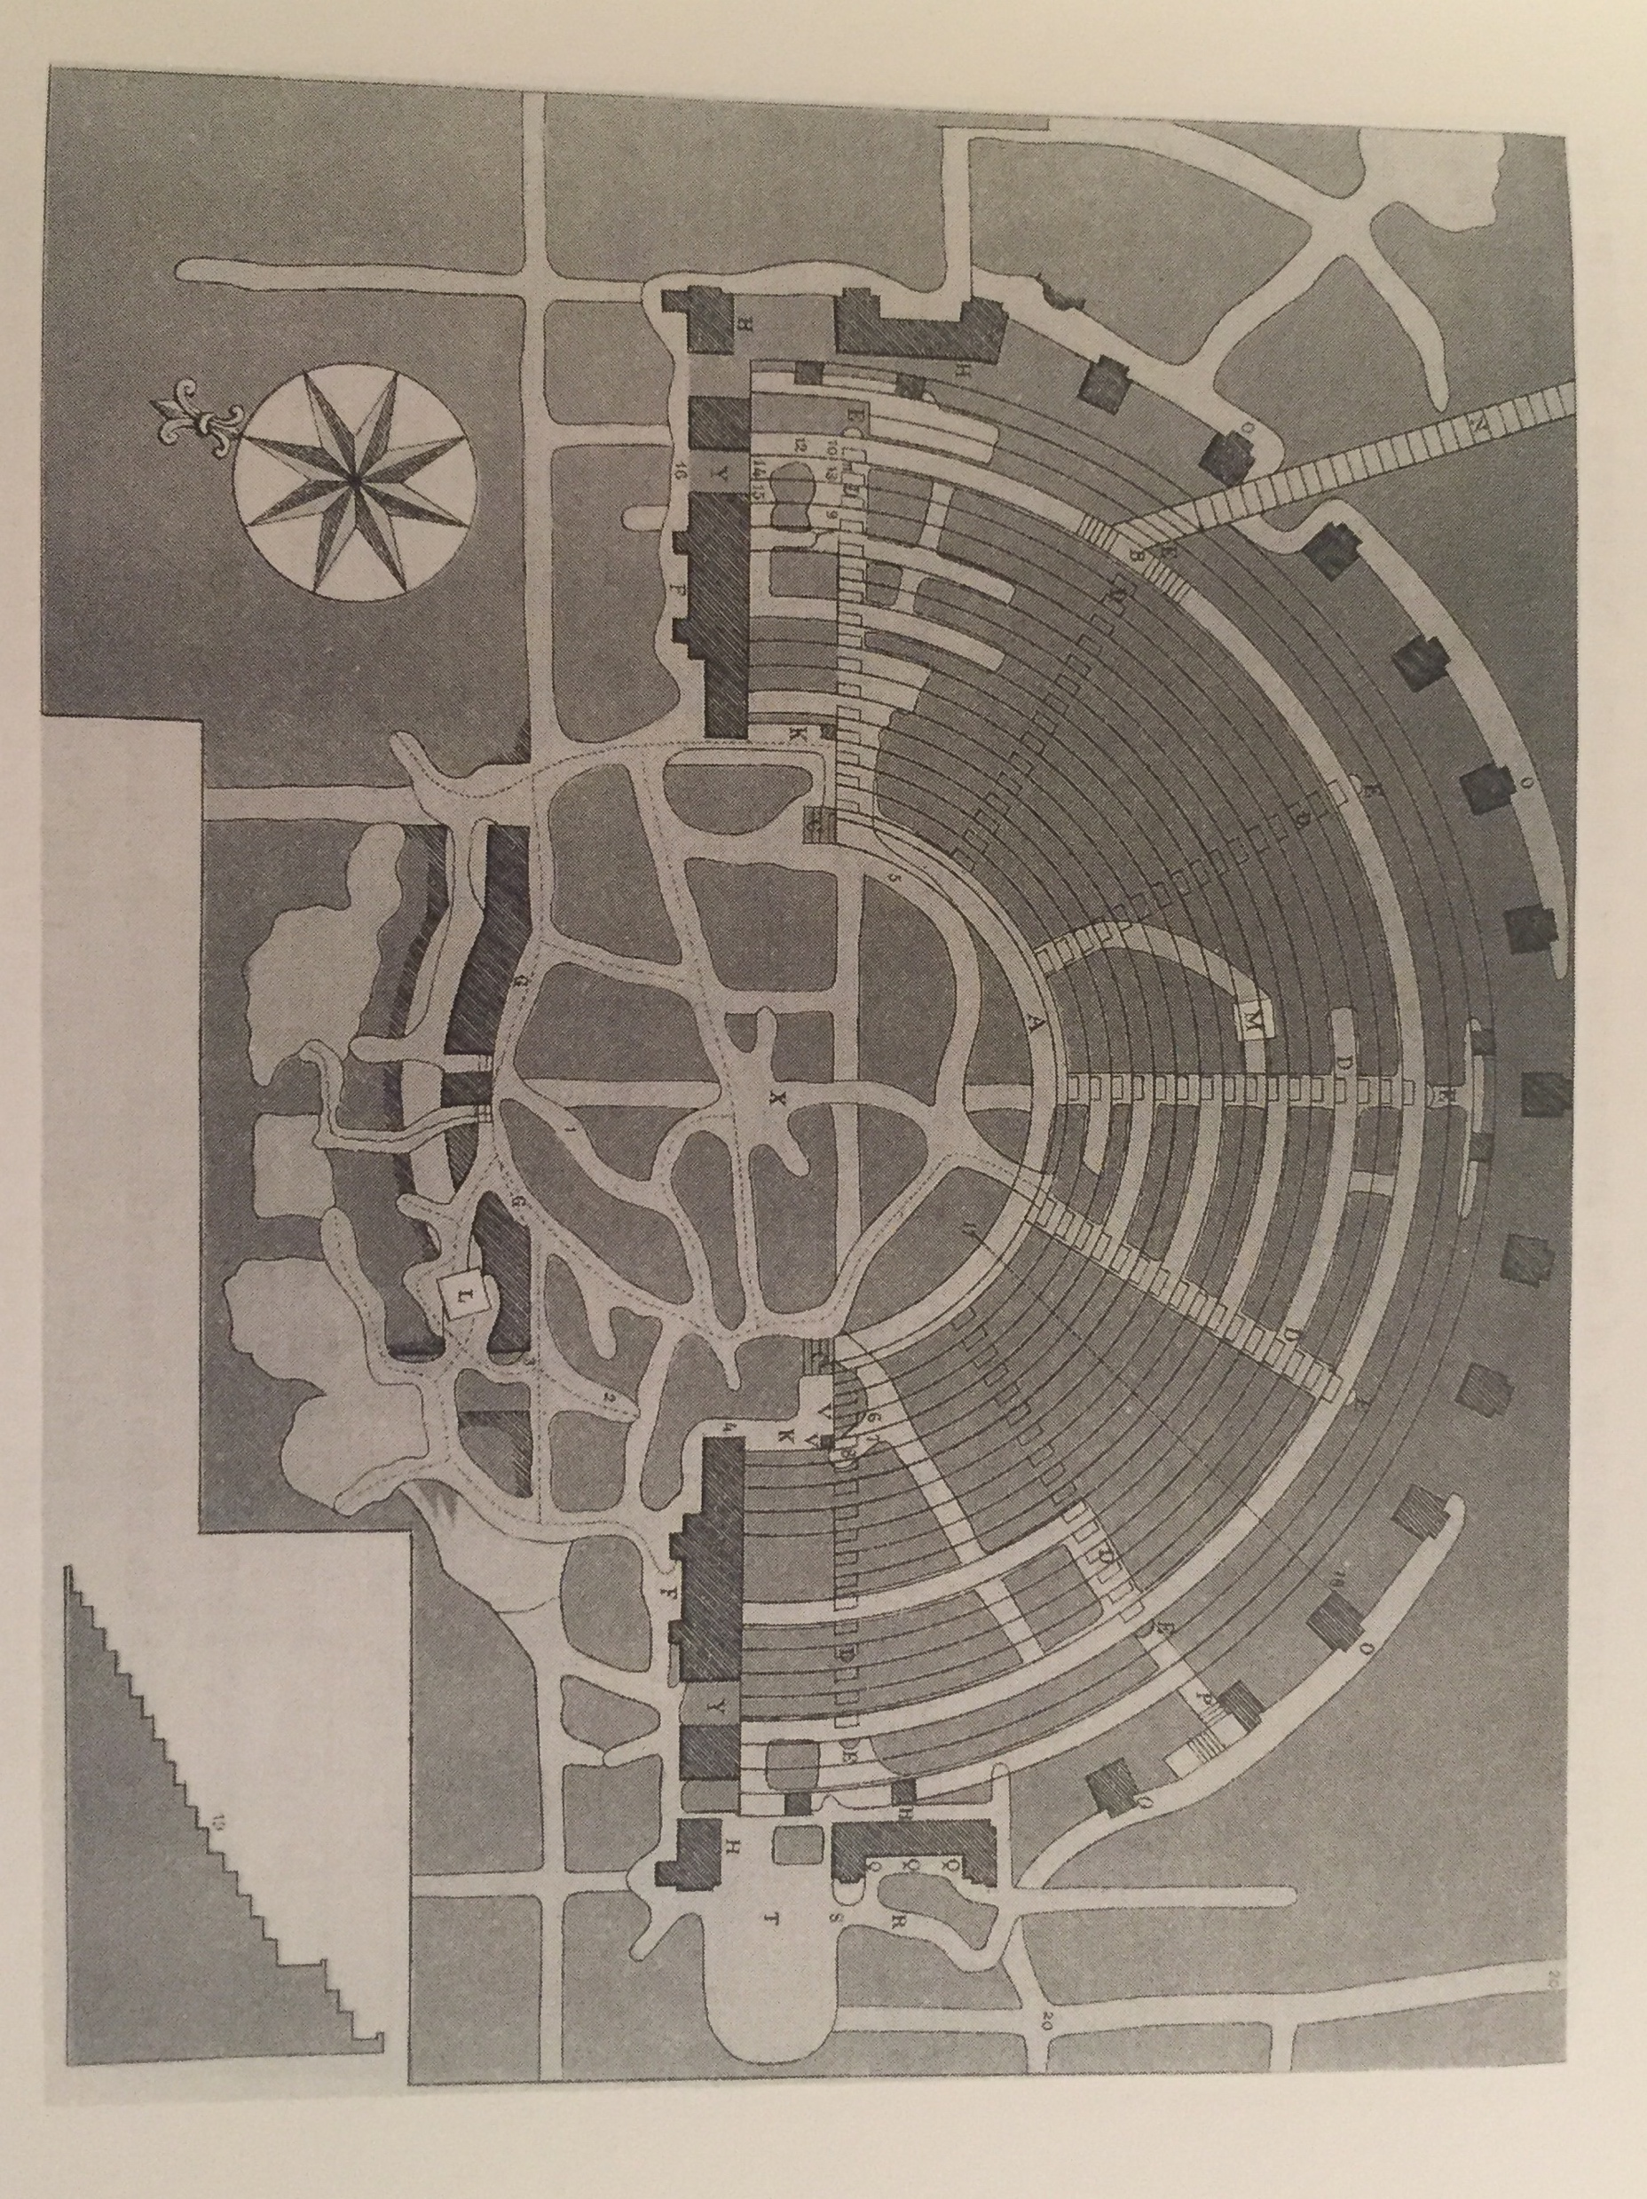
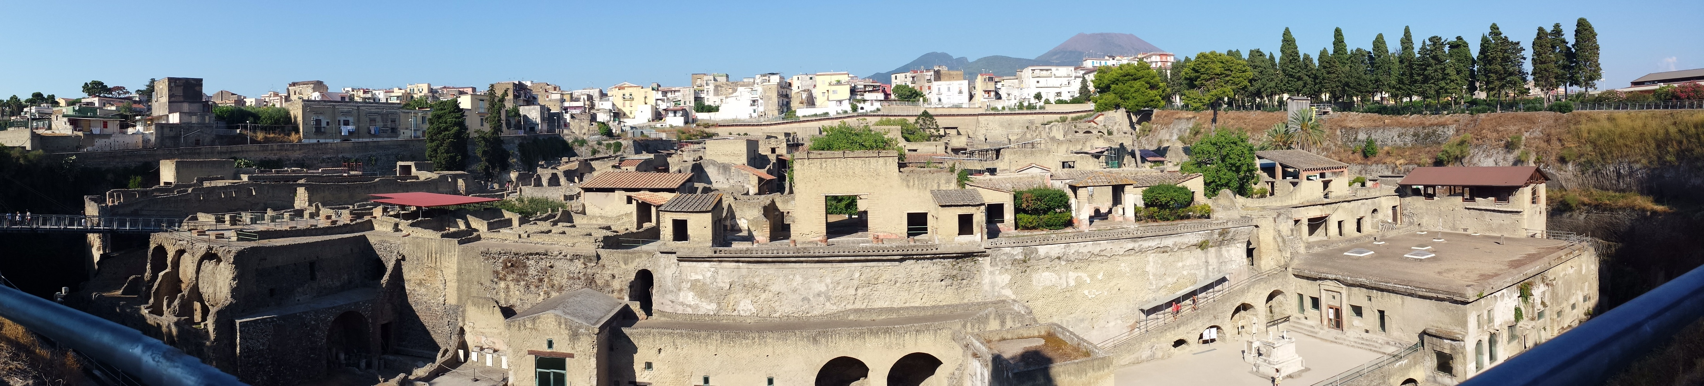
Herculaneum
Notes:
Journal, organized, drawings

Slide 6
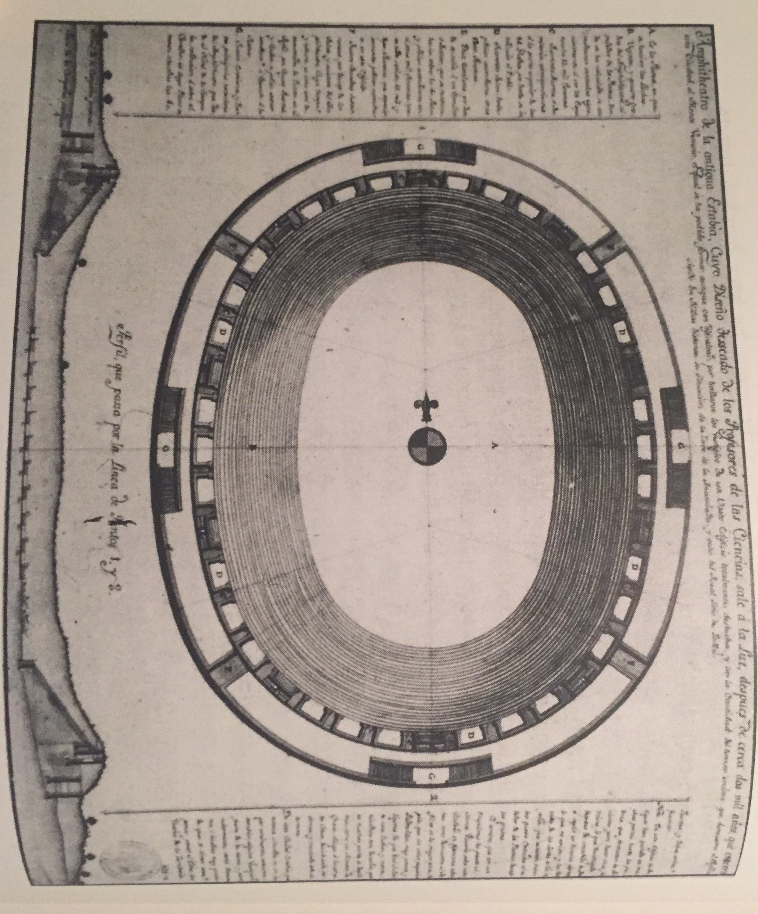
Pompeii
Notes:
Amphitheater first discovered; Weber in charge physically, Alcubierre supervisor; believed to be Civita; sick between 1741-1745,; The interest of these excavations focused, fundamentally, on the recovery of artistic objects to be exhibited later in the royal collections

Slide 7
Significance
Catalyst for archaeology
Destruction and preservation
Depiction of Roman life
New archaeological development
Notes:
Digital canning recording; attempts to conserve exhibits

Slide 8
Later Life
Continued work in Sorrento, Capri, Cumas
Military ranks
Disputes – Johann Joachim Winckelmann, Karl Weber, Francesco de la Vega
Died March 14, 1780 in Naples
Notes:
Scandal

Slide 9
Bibliography
Aragoncurioso. “Roque Joaquín De Alcubierre, The Zaragozano Who Discovered Pomepii.” Aragoncurioso.Wordpress, Wordpress, 8 June 2015, aragoncurioso.wordpress.com/2015/06/08/roque-joaquin-de-alcubierre-el-zaragozano-que-descubrio-pompeya/.
Leonor, Alma. “Roque Joaquín De Alcubierre, De Zaragoza a Pompeya.” VAVEL.com, Vavel, 29 Dec. 2017, www.vavel.com/es/historia/858616-roque-joaquin-de-alcubierre-de-zaragoza-a-pompeya.html.
Parslow, Christopher Charles. Rediscovering Antiquity Karl Weber and the Excavation of Herculaneum, Pompeii, and Stabiae. Rediscovering Antiquity Karl Weber and the Excavation of Herculaneum, Pompeii, and Stabiae, Cambridge University Press, 2011.
“ROQUE JOAQUÍN ALCUBIERRE.” Zaragoza Ayuntamiento , 9 Mar. 2006, www.zaragoza.es/ciudad/museos/es/chistoria/alcubierre.htm.
Ruiz, Fico. “Roque Joaquín de Alcubierre, El Descubridor de Pompeya y Herculano.” Aragonautas, Blogger, 1 Jan. 1970, aragonautas.blogspot.com/2013/10/roque-joaquin-de-alcubierre-el.html.

